Slide 1
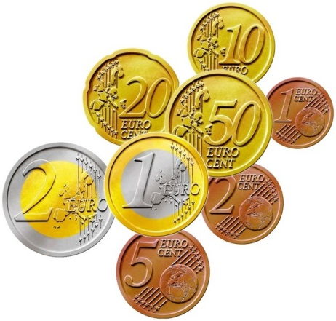
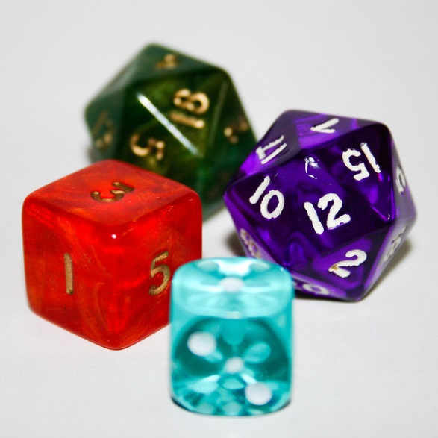

My Probability Interactive Notebook
Name
Class
Teacher
Term 4 Semester 2
1

Slide 2
Contents
Glossary or Formula Page
Page
Date
Description
2
3

Slide 3
Tasks
24
7
30
Essential Question
Questions
Notes
Summary
4
5

Slide 4
24
7
30
Date
Theoretical Probability
EQ – How do I work out probabilities Theoretically?
The Theory Says...
Sample Space
The sample space, sometimes called and event space, is a listing of all the possible outcomes that could arise from an experiment.
For example
tossing a coin would have a sample space of {Head, Tail}, or {H,T}
rolling a dice would have a sample space of {1,2,3,4,5,6}
watching the weather could have a sample space of {sunny, cloudy, rainy} or {hot, cold}
asking questions in a survey of favourite seasons could have a sample space of {Summer, Autumn, Winter, Spring}
Did you also notice how I listed the sample space? Using curly brackets { }.
7

Slide 5
24
7
30
Date
Theoretical Probability
EQ – How do I work out probabilities Theoretically?
Event
An event is the word used to describe a single result from within the sample space. It helps us to identify which of the sample space outcomes we might be interested in.
For example, these are all events.
Getting a tail when a coin is tossed.
Rolling more than 3 when a dice is rolled
Getting an ACE when a card is pulled from a deck
We use the notation, P(event) to describe the probability of particular events.
Adding up how many times an event occurred during an experiment gives us the frequency of that event.
The relative frequency is how often the event occurs compared to all possible events and is also known as the probability of that event occurring.
7

Slide 6
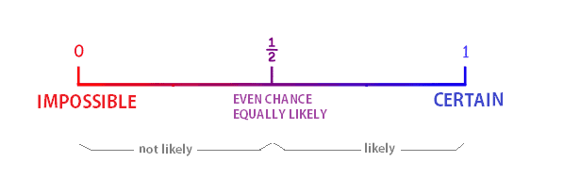
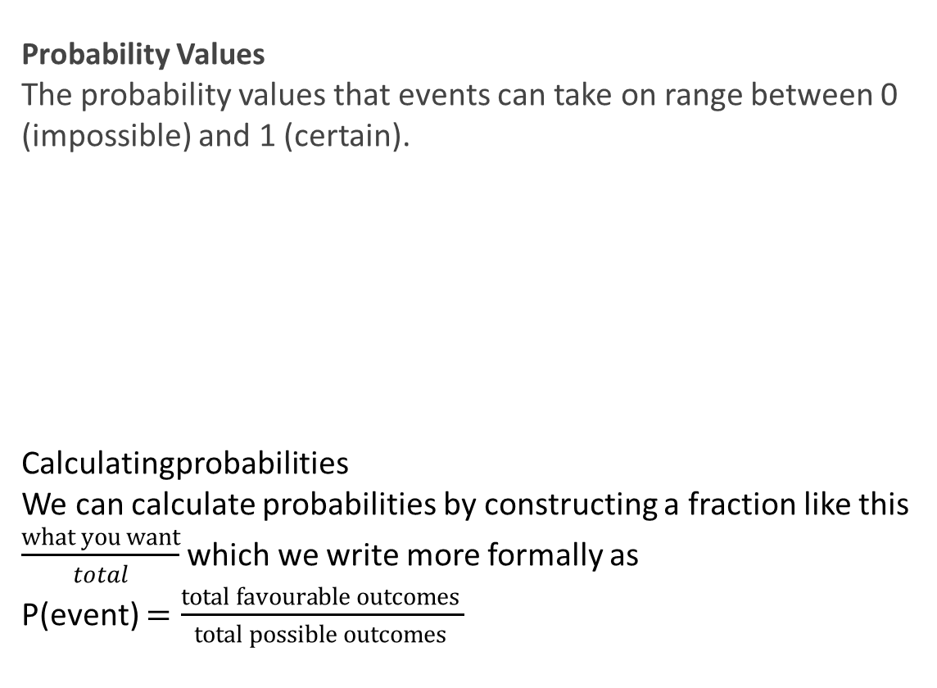
24
7
30
Date
Theoretical Probability
EQ – How do I work out probabilities Theoretically?
Probability Values
The probability values that events can take on range between 0 (impossible) and 1 (certain).
Calculatingprobabilities
We can calculate probabilities by constructing a fraction like this $\frac{what you want}{total}$ which we write more formally as
P(event) $=\frac{total favourable outcomes }{total possible outcomes }$
7

Slide 7
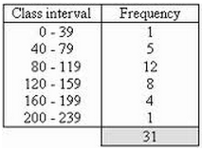
24
7
30
Date
Theoretical Probability
EQ – How do I work out probabilities Theoretically?
Other Ways to Calculate Probabilities
As we are beginning to see, probabilities occur in a wide variety of situations and we can visualise them through a wide variety of diagrams and tables.
Probabilities are also used in statistical analysis, usually as a way of predicting what might happen in the future based on past events that have been researched and recorded.
Obtaining probabilities from frequency tables
7

Slide 8
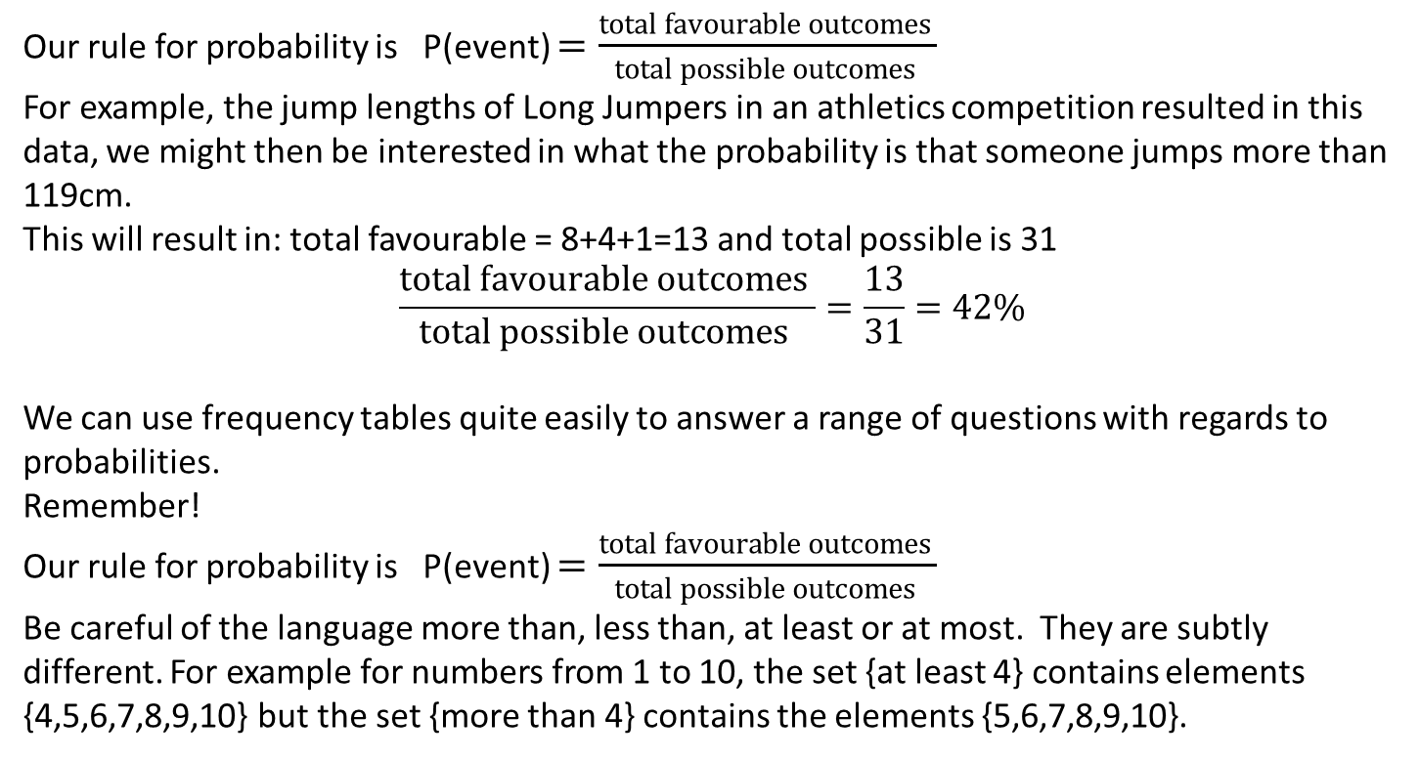
24
7
30
Date
Theoretical Probability
EQ – How do I work out probabilities Theoretically?
Our rule for probability is P(event) $=\frac{total favourable outcomes }{total possible outcomes }$
For example, the jump lengths of Long Jumpers in an athletics competition resulted in this data, we might then be interested in what the probability is that someone jumps more than 119cm.
This will result in: total favourable = 8+4+1=13 and total possible is 31
$$\frac{total favourable outcomes }{total possible outcomes }=\frac{13}{31}=42\%$$
We can use frequency tables quite easily to answer a range of questions with regards to probabilities.
Remember!
Our rule for probability is P(event) $=\frac{total favourable outcomes }{total possible outcomes }$
Be careful of the language more than, less than, at least or at most. They are subtly different. For example for numbers from 1 to 10, the set {at least 4} contains elements {4,5,6,7,8,9,10} but the set {more than 4} contains the elements {5,6,7,8,9,10}.
7

Slide 9
Exercises
Page 194
Ex 14.5 Two way tables ones

Slide 10
Notes Review
24, 7 ,30
Date
Title
Essential question
Notes complete
Notes complete with colour and diagrams
Questions completed
Contents page filed in
Formula page filled in

Slide 11
Homework
Review your notes and write a summary answering the essential question.

